Slide 1
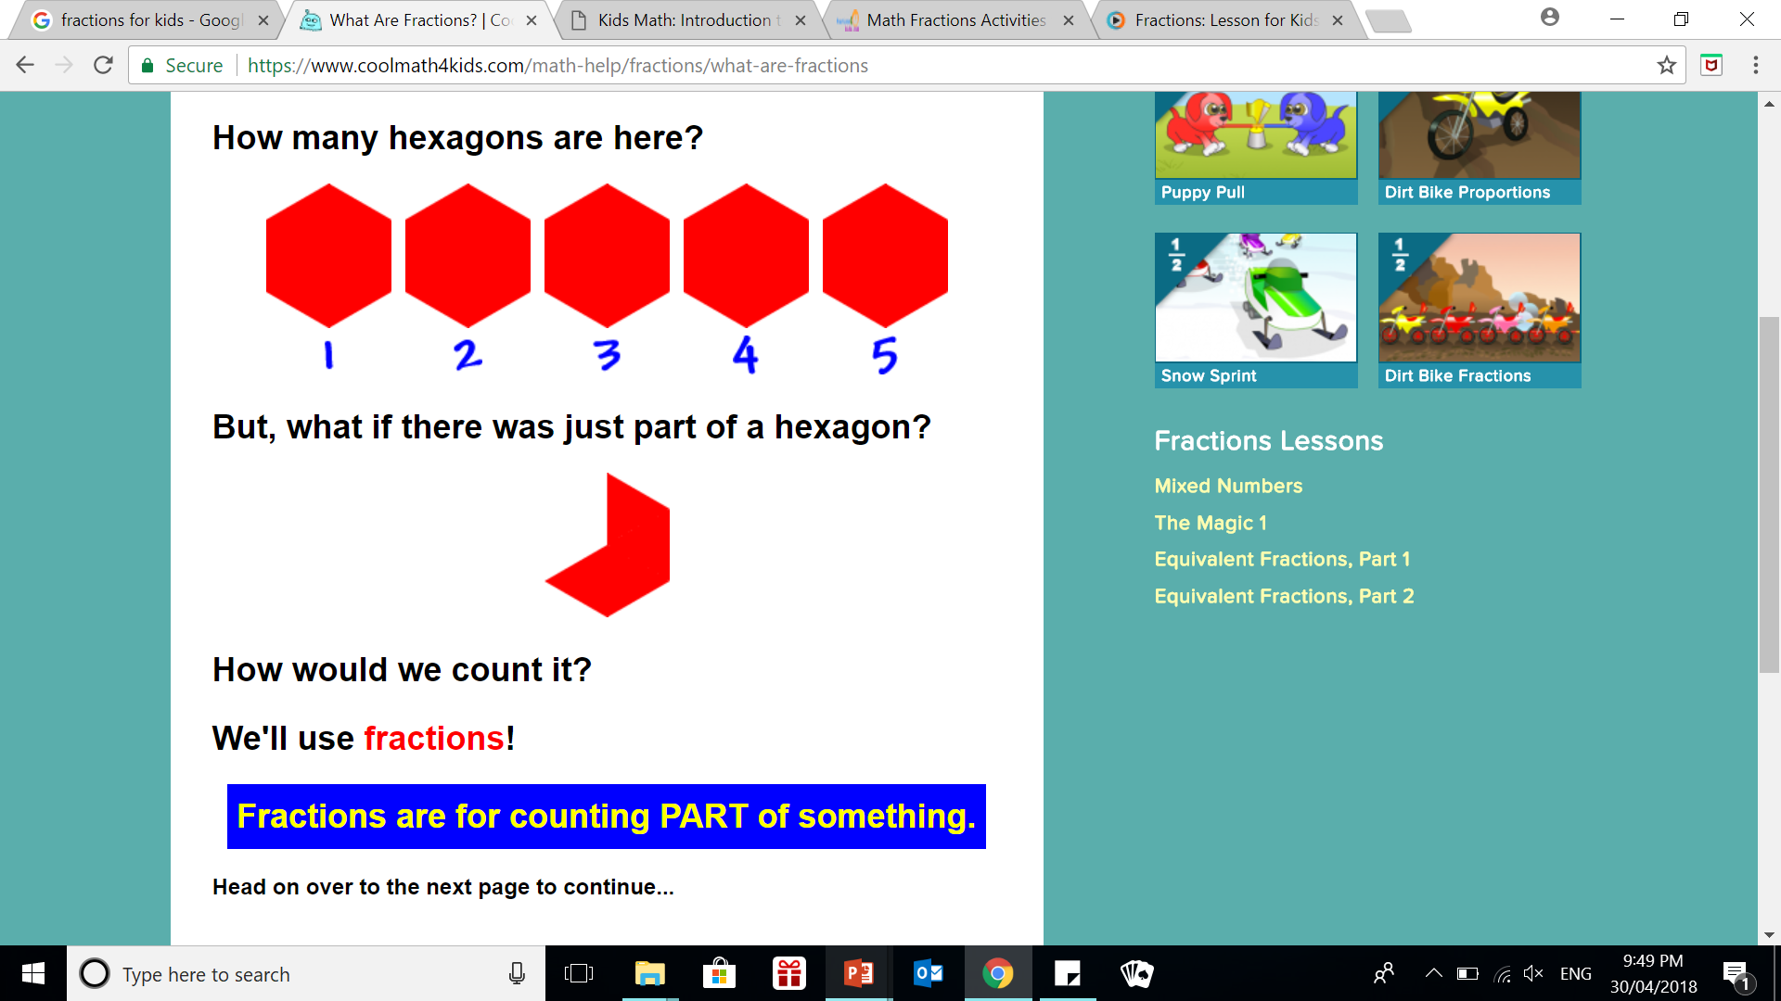
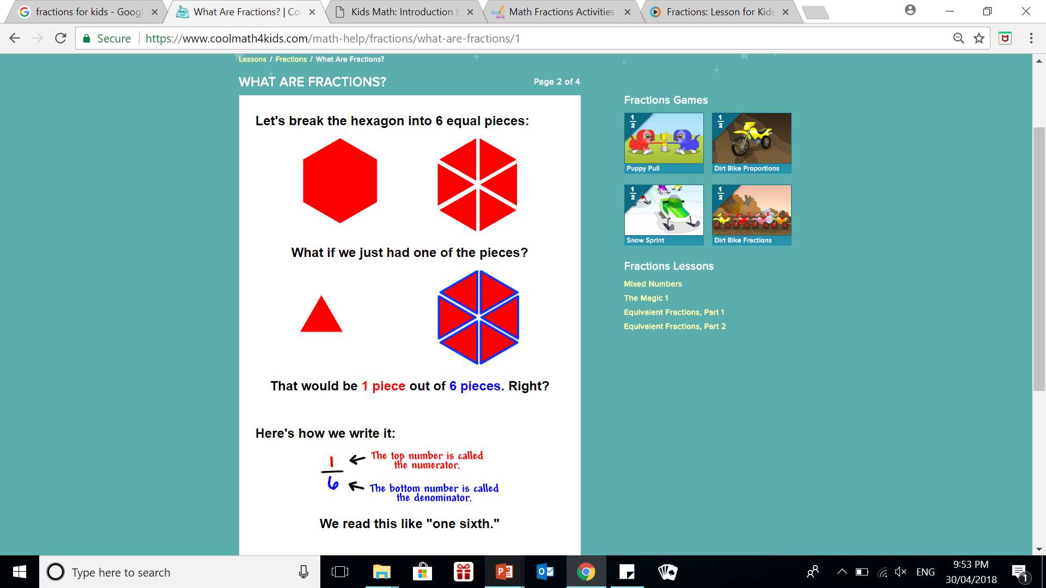
24
7
30
Date
Introduction to fractions
EQ – what is a fraction?
What is a fraction? A fraction represents part of a whole.

Slide 2
24
7
30
Date
Introduction to fractions
EQ – what is a fraction?

Slide 3
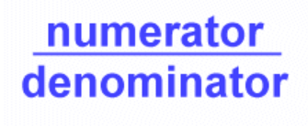
24
7
30
Date
Introduction to fractions
EQ – what is a fraction?
Numerator and Denominator
The numerator is how many parts you have.
The denominator is how many parts the whole was divided into.

Slide 4
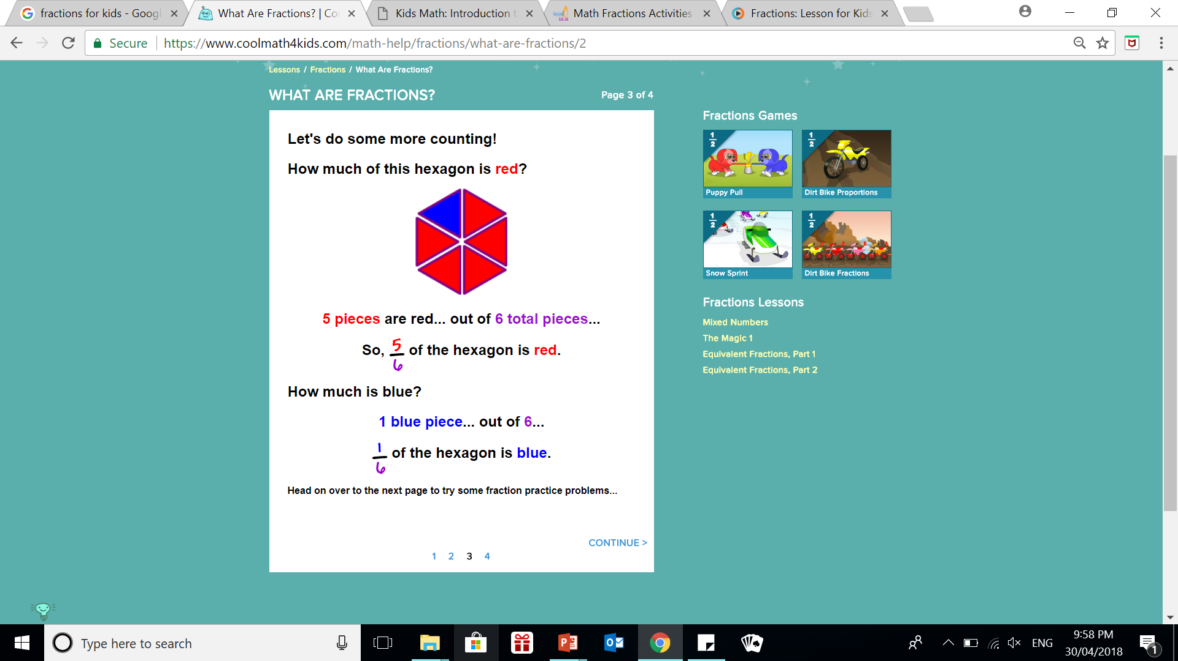
24
7
30
Date
Introduction to fractions
EQ – what is a fraction?

Slide 5
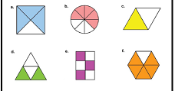
24
7
30
Date
Introduction to fractions
EQ – what is a fraction?

Slide 6
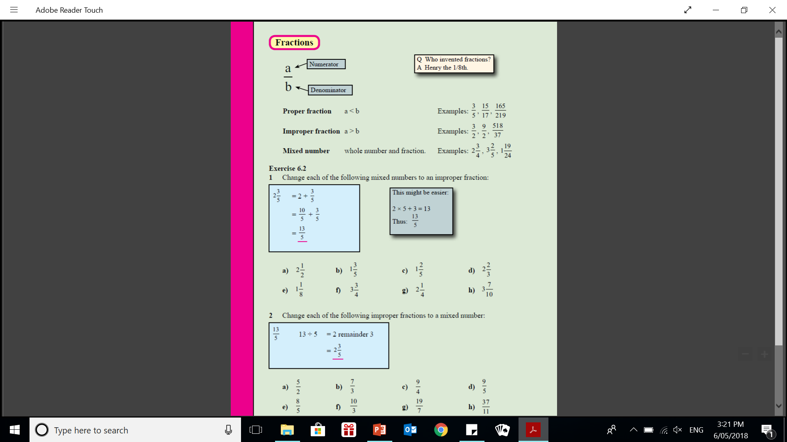

24
7
30
Date
Introduction to fractions
EQ – what is a fraction?
Naming fractions
PROPER FRACTIONS
$Numerator<Denominator$
IMPROPER FRACTIONS
$Numerator>Denominator$
MIXED FRACTIONS
$whole number and fraction$

Slide 7
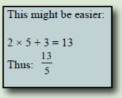
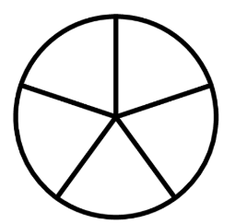
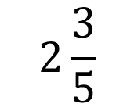
24
7
30
Date
Introduction to fractions
EQ – what is a fraction?
Changing mixed numbers to fractions
$$2\frac{3}{5}$$

Slide 8
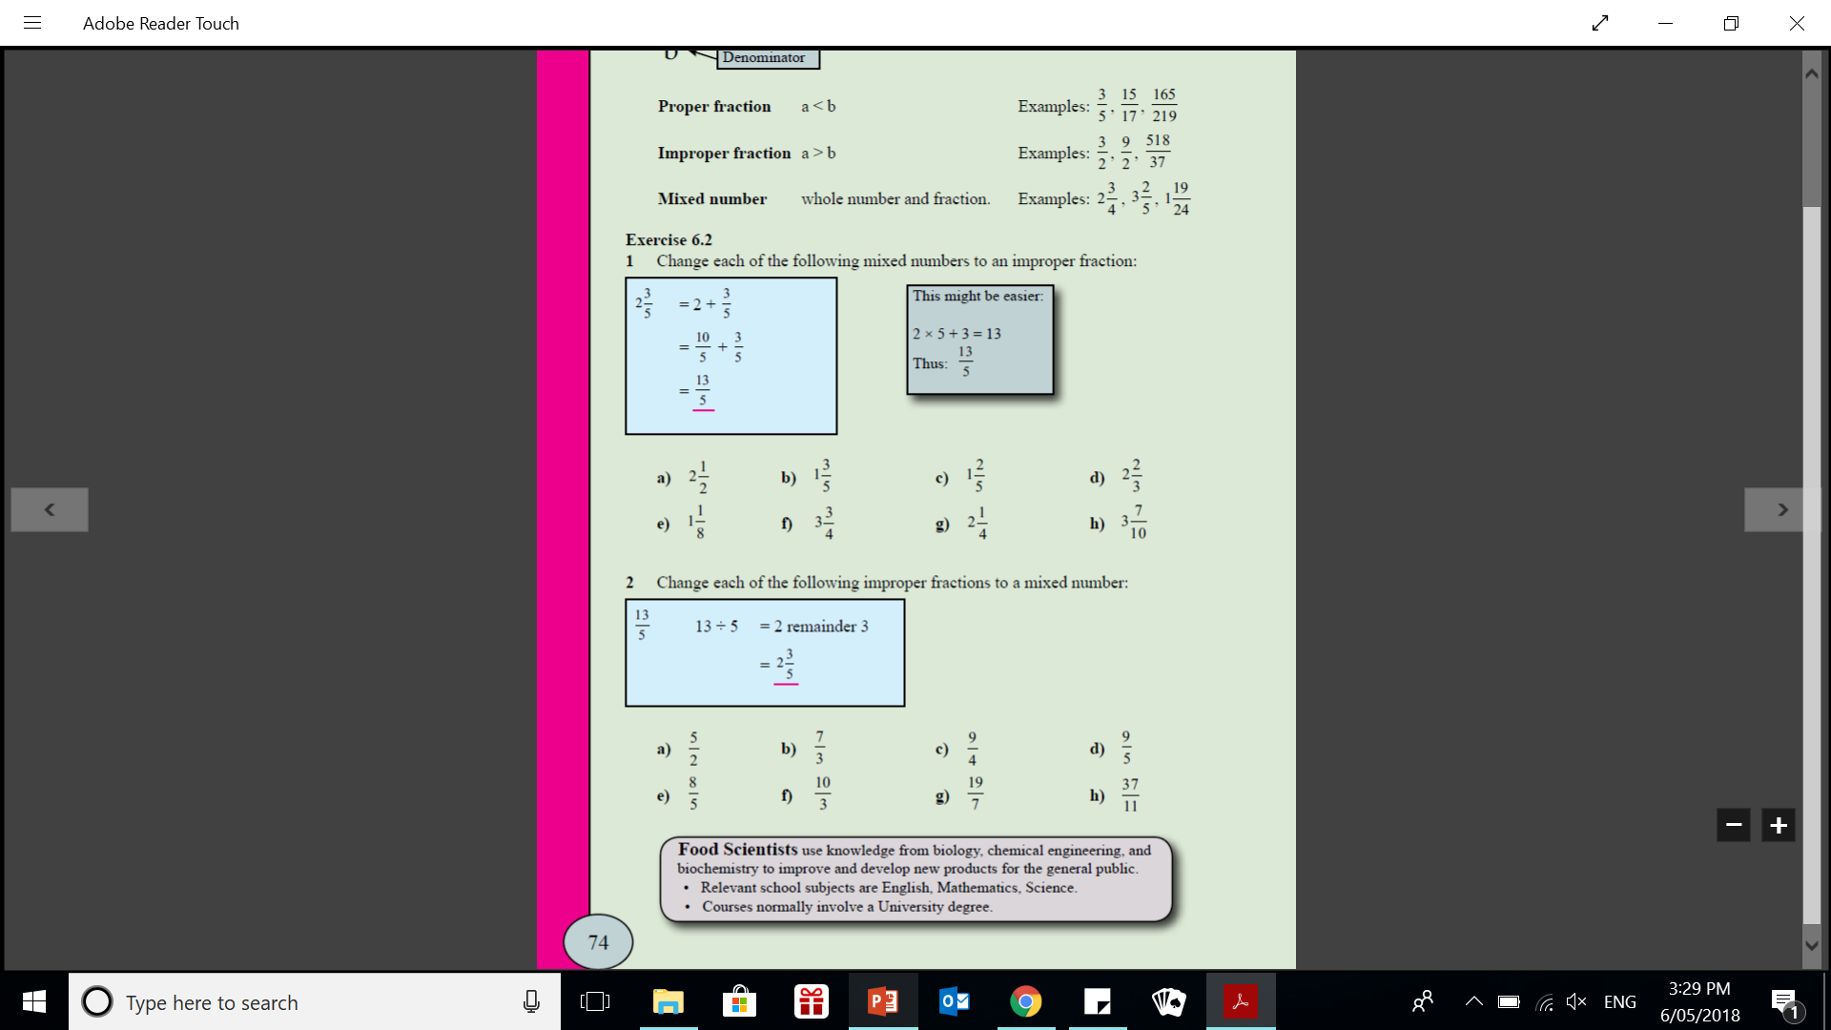

Slide 10
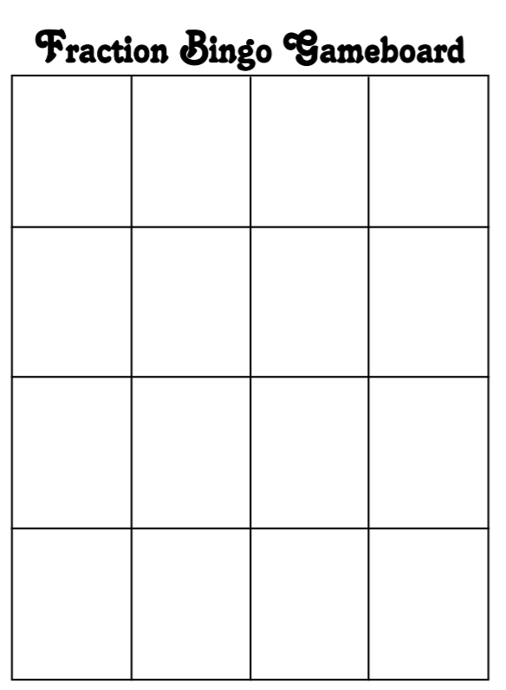
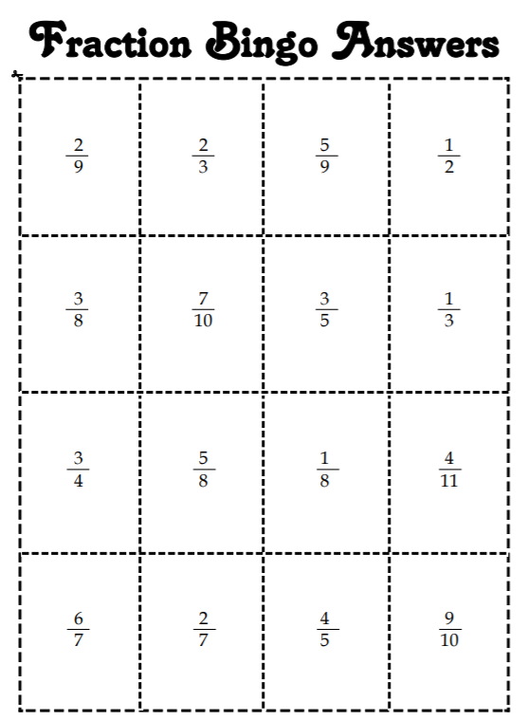
Fraction bingo – cut and glue answers ANYWHERE onto board game

